Slide 1
Memory
Chapter 7

Slide 2
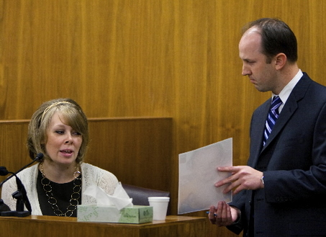
Memory
Constructive processing
  Memory gaps filled by logic, guessing, or new information
  Forensic eyewitness accounts
    Ronald Cotton
    http://www.cbsnews.com/video/watch/?id=5153451n
    Distortion
    Contamination
    Influences
    http://www.cbsnews.com/video/watch/?id=4852622n&tag=segementExtraScroller;housing
Deliberate manipulation
  The “bunny effect” http://www.cbsnews.com/video/watch/?id=4852620n

Slide 3
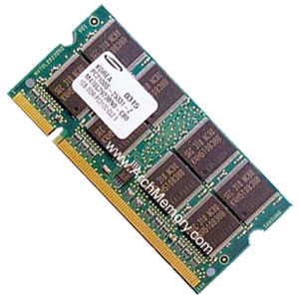
Memory
What is memory?
  An active system that…
    Receives
    Stores
    Organizes
    Alters
    Recovers information

Slide 4
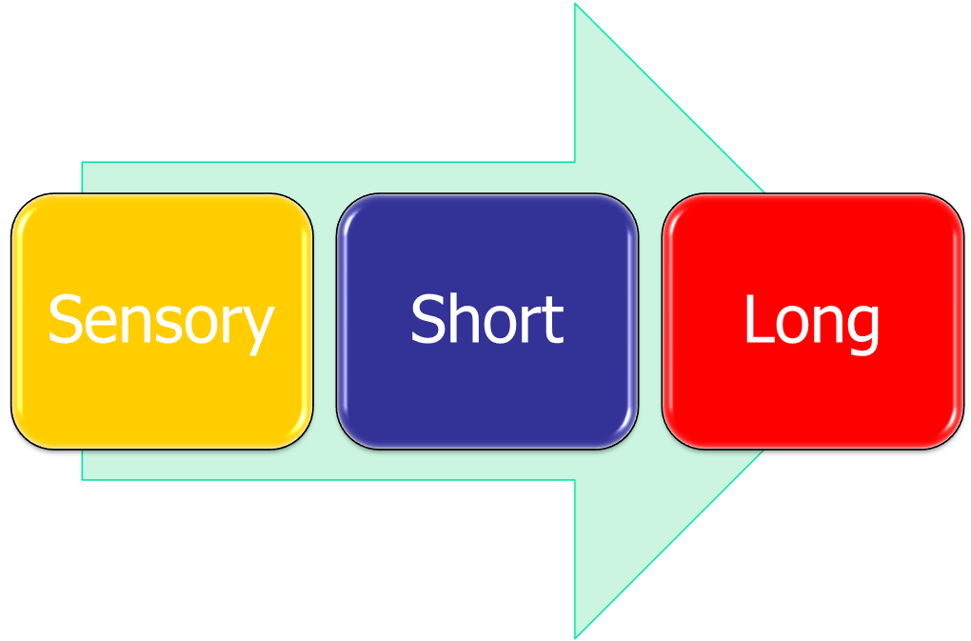
Memory
Memory types

Slide 5
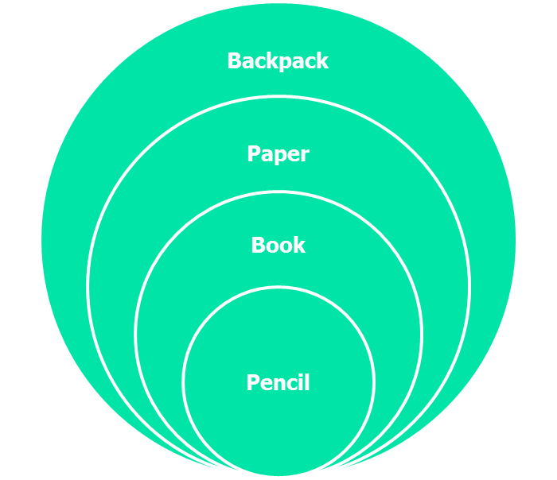
Memory
Short Term Memory
  Information chunks
    5-7 bits of information grouped into larger units
    Reorganizes, “stacks”, information into units that are already in LTM
    Numbers, letters, words, phrases, sentences
  Maintenance rehearsal
    Silent repetitions
  Elaborative encoding
    Makes information meaningful

Slide 6


Memory
Types of Long Term Memory
  (page 250)
  Clive Wearing – the “Memento Syndrome” http://youtu.be/WmzU47i2xgwo
    Amnesia
      Retrograde
      Anterograde
    Procedural
    Declarative
    Semantic
    Episodic

Slide 7
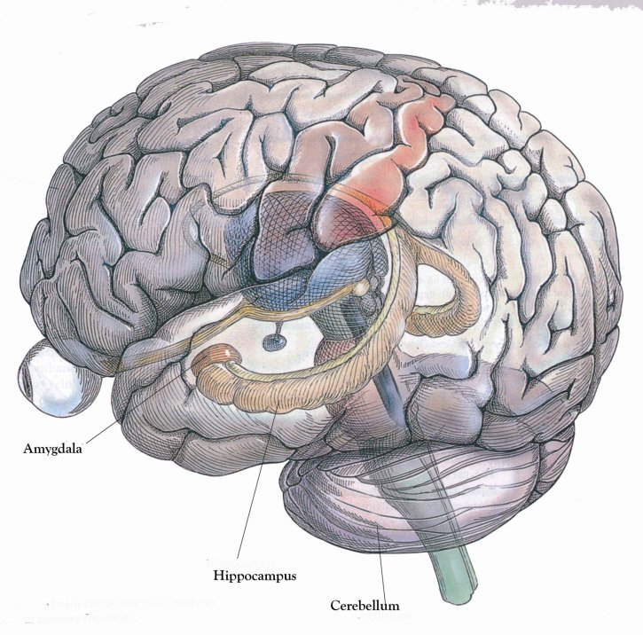
Memory
Stress http://youtu.be/OHl7BewJ0yU
  Forgetting
  Lapses
  Hippocampus
    Neuron firing
    Neuron connections
Post Traumatic Stress Disorder
  Interference
  Repression and Suppression
  Implicit memory
  Explicit memory

Slide 8
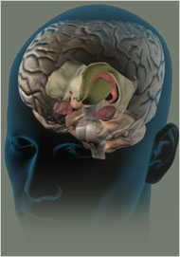
Memory
Improving your memory (pp. 265-268
  Discuss in your research group
    Encoding strategies
    Retrieval strategies
Mapping Memory in the Brain
    Dr. Eric Kandel
    http://youtu.be/MCkji-0aqHo

